Slide 1


http://www.comp.nus.edu.sg/~cs2100/
Recitation-3
MIPS – 1 & 2
L7 and L8 videos

Slide 2



Slide 3

In the huge, mind-blowing space out there, our Earth is just a tiny speck of blue, a single dot holding all our happiness, sadness, problems, and victories. It's like a reminder that all the big issues we face are actually packed into this one little spot. Think about it: this small dot has the power for huge changes and loads of hope. We're all in this together, tackling our challenges and making things better, all from this one spot in the vast universe. It shows we're all connected in our journey to create a brighter future.
Notes:
In the huge, mind-blowing space out there, our Earth is just a tiny speck of blue, a single dot holding all our happiness, sadness, problems, and victories. It's like a reminder that all the big issues we face are actually packed into this one little spot. Think about it: this small dot has the power for huge changes and loads of hope. We're all in this together, tackling our challenges and making things better, all from this one spot in the vast universe. It shows we're all connected in our journey to create a brighter future.

Slide 4
Agenda
Demo of Motherboard
Summary
Quiz Questions
Mentimeter Quiz

Slide 5
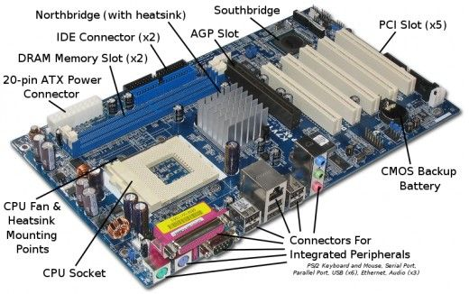
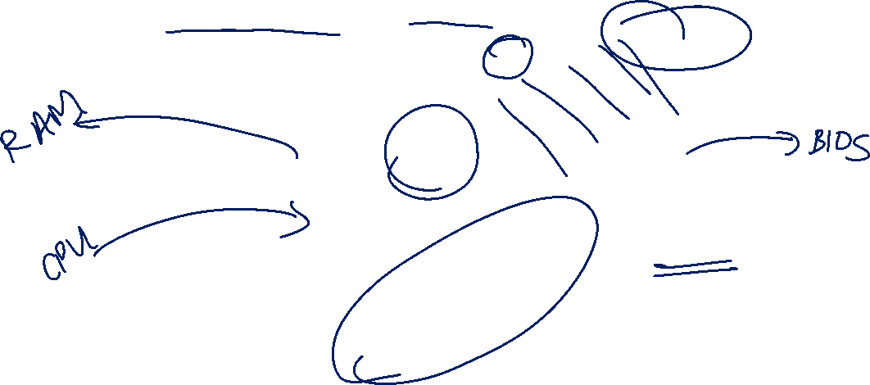
Motherboard
Source: https://www.pinterest.com/pin/226024475021843532/

Slide 6
Summary

Slide 7
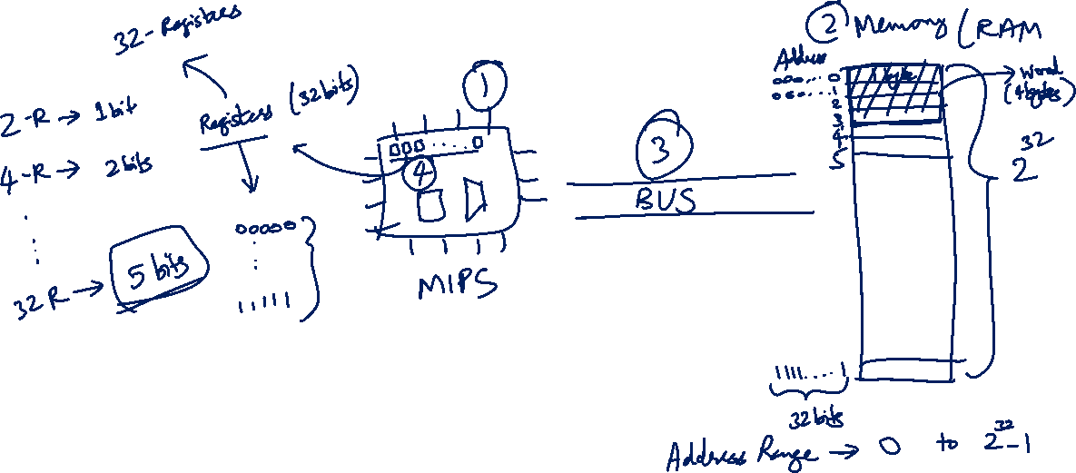
MIPS-Register/Address/Memory/Processor???

Slide 8
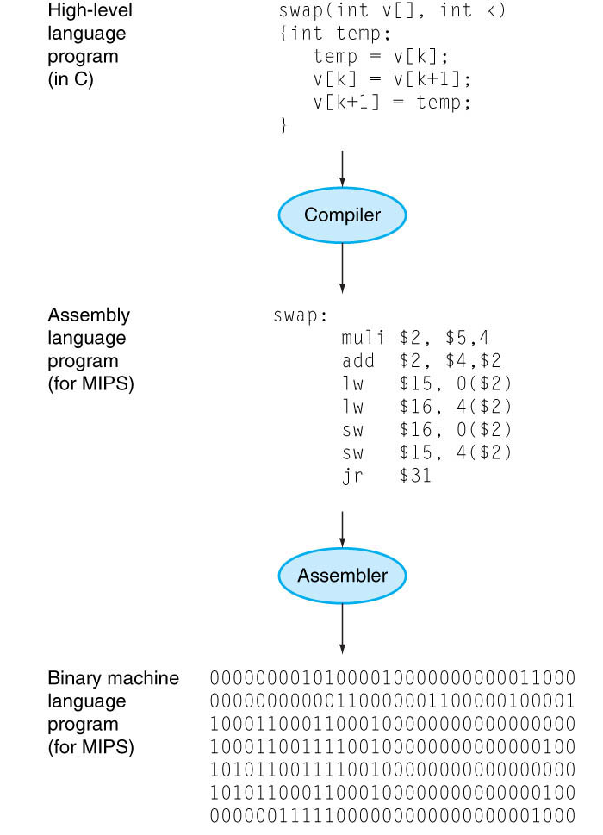
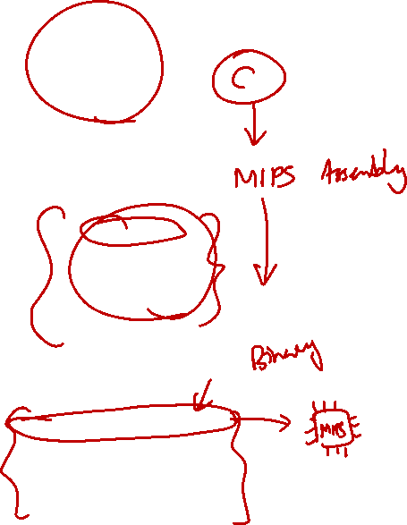
Recap
You write programs in high-level programming languages, e.g., C/C++, Java:
Compiler translates this into assembly language statement:
Assembler translates this statement into machine language instructions that the processor can execute:
A + B
add A, B
1000 1100 1010 0000

Slide 9

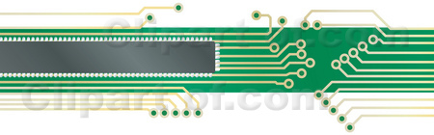
1. Instruction Set Architecture (1/2)
Instruction Set Architecture (ISA):
An abstraction on the interface between the hardware and the low-level software.
Software
(to be translated to the instruction set)
Instruction Set Architecture
Hardware
(implementing the instruction set)

Slide 10
1. Instruction Set Architecture (2/2)
Instruction Set Architecture
Includes everything programmers need to know to make the machine code work correctly
Allows computer designers to talk about functions independently from the hardware that performs them
This abstraction allows many implementations of varying cost and performance to run identical software.
Example: Intel x86/IA-32 ISA has been implemented by a range of processors starting from 80386 (1985) to Pentium 4 (2005)
Other companies such as AMD and Transmeta have implemented IA-32 ISA as well
A program compiled for IA-32 ISA can be executed on any of these implementations

Slide 11
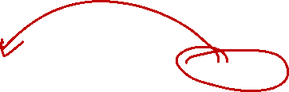
2. Machine Code vs Assembly Language
Machine Code | Assembly Language
Instructions in binary e.g.: 1000 1100 1010 0000 → Add two numbers | Human readable e.g.: add A, B → Add two numbers
Hard and tedious to code | Easier to write than machine code, symbolic version of machine code
1000 1100 1010 0000 ← ASSEMBLER ← add A, B
May also be written in hexadecimal for a more human-readable format | May provide ‘pseudo-instructions’ as syntactic sugar
 | When considering performance, only real instructions are counted
NOTE:
Syntactic "sugar" is basically a translation scheme from a language to the same language (e.g., from C to C or in this case from MIPS to MIPS). The pseudo-instructions are then translated into one or more real instructions.
For example, in MIPS, we have move $rd, $rs being translated into add $rd, $rs, $zero.

Slide 12
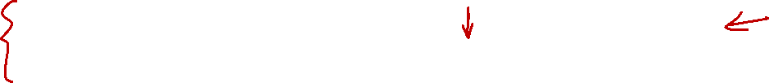
3. Walkthrough: An Example Code (1/15)
Let us take a journey with the execution of a simple code:
Discover the components in a typical computer
Learn the type of instructions required to control the processor
Simplified to highlight the important concepts ☺
// assume res is 0 initially
for (i=1; i<10; i++) {
res = res + i;
}
res ← res + i
i ← i + 1
if i < 10, repeat
compile to
C-like code fragment
“Assembly” Code
NOTE:
Not a real "assembly" language but hopefully instructive enough for our purpose.

Slide 13
3. Walkthrough: The Components (2/15)
The two major components in a computer
Processor and Memory
Input/Output devices omitted in this example
Processor
Memory
Bus
Storage of code and data
Perform computations
Bridge between the two components
NOTE:
"Bus" is really just a data connector between memory and processor. Memory is typically simply a RAM.

Slide 14
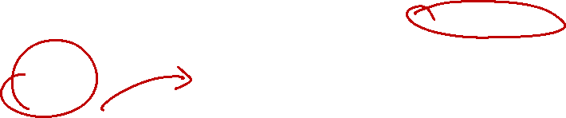
3. Walkthrough: The Code in Action (3/15)
The code and data reside in memory
Transferred into the processor during execution
Processor
Memory
Inst
res ← res + i
Bus
………..
res ← res + i
i ← i + 1
ALU
res+i
if i < 10,
………
i
1
res
0
………..

Slide 15
3. Walkthrough: Memory Access is Slow! (4/15)
To avoid frequent access of memory
Provide temporary storage for values in the processor (known as registers)
Processor
Memory
Inst
Bus
………..
res ← res + i
r0
i ← i + 1
r1
ALU
if i < 10,
..
…
………
i
1
res
0
………..

Slide 16
3. Walkthrough: Memory Instruction (5/15)
Need instruction to move data into registers
Also to move data from registers to memory later
Memory
Processor
………..
r0 ← load i
Inst
r0 ← load i
r1 ← load res
Bus
res ← res + i
r0
1
i ← i + 1
r1
ALU
if i < 10,
..
…
………
i
1
Moving data from memory into a register – load
Moving data from a register into memory – store
res
0
………..

Slide 17
3. Walkthrough: Memory Instruction (6/15)
Need instruction to move data into registers
Also to move data from registers to memory later
Memory
Processor
………..
r0 ← load i
Inst
r1 ← load res
r1 ← load res
Bus
res ← res + i
r0
1
i ← i + 1
r1
0
ALU
if i < 10,
..
…
………
i
1
Moving data from memory into a register – load
Moving data from a register into memory – store
res
0
………..

Slide 18
3. Walkthrough: Reg-to-Reg Arithmetic (7/15)
Arithmetic operations can now work directly on registers only (much faster!)
Memory
Processor
………..
r0 ← load i
Inst
r1 ← r1 + r0
r1 ← load res
Bus
r1 ← r1 + r0
r0
1
r0 ← r0 + 1
ALU
if r0 < 10,
r1
0
1
..
…
………
i
1
res
0
………..

Slide 19
3. Walkthrough: Reg-to-Reg Arithmetic (8/15)
Sometimes, arithmetic operation uses a constant value instead of register value
Memory
Processor
………..
r0 ← load i
Inst
r0 ← r0 + 1
r1 ← load res
Bus
r1 ← r1 + r0
r0
2
r0 ← r0 + 1
1
ALU
r1
1
if r0 < 10,
1
..
…
………
i
1
res
0
………..

Slide 20

3. Walkthrough: Execution Sequence (9/15)
Instruction is executed sequentially by default
How do we “repeat” or “make a choice”?
Memory
Processor
………..
r0 ← load i
Inst
r1 ← load res
Bus
r1 ← r1 + r0
r0
r0 ← r0 + 1
ALU
if r0 < 10,
r1
..
…
………
i
1
res
0
………..

Slide 21

3. Walkthrough: Control Flow (10/15)
We need instructions to change the control flow based on condition:
Repetition (loop) and Selection (if-else) can both be supported
Memory
Processor
………..
r0 ← load i
Inst
if r0 < 10, repeat
r1 ← load res
Bus
r1 ← r1 + r0
r0
2
r0 ← r0 + 1
ALU
if r0 < 10,
r1
1
..
…
………
i
1
res
0
………..

Slide 22
3. Walkthrough: Looping! (11/15)
Since the condition succeeded, execution will repeat from the indicated position
Memory
Processor
………..
r0 ← load i
Inst
r1 ← r1 + r0
r1 ← load res
Bus
r1 ← r1 + r0
r0
2
r0 ← r0 + 1
ALU
if r0 < 10,
r1
1
3
..
…
………
i
1
res
0
………..

Slide 23
3. Walkthrough: Looping! (12/15)
Execution will continue sequentially
Until we see another control flow instruction
Memory
Processor
………..
r0 ← load i
Inst
r0 ← r0 + 1
r1 ← load res
Bus
r1 ← r1 + r0
2
r0 ← r0 + 1
r0
3
ALU
r1
3
if r0 < 10,
1
..
…
………
i
1
res
0
………..

Slide 24
3. Walkthrough: Looping! (13/15)
The three instructions will be repeated until the condition fails
Memory
Processor
………..
r0 ← load i
Inst
if r0 < 10, repeat
r1 ← load res
Bus
r1 ← r1 + r0
r0
10
r0 ← r0 + 1
ALU
if r0 < 10,
r1
45
..
…
………
i
1
res
0
………..

Slide 25
3. Walkthrough: Memory Instruction (14/15)
We can now move back the values from register to their “home” in memory
Similarly for “r1” to “res”
Memory
Processor
………..
r0 ← load i
Inst
i ← store r0
r1 ← load res
Bus
r1 ← r1 + r0
r0
10
r0 ← r0 + 1
ALU
if r0 < 10,
r1
45
..
…
i ← store r0
………
i
1
10
res
0
………..

Slide 26
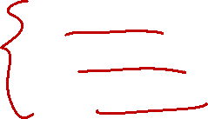
3. Walkthrough: Summary (15/15)
The stored-memory concept:
Both instruction and data are stored in memory
The load-store model:
Limit memory operations and relies on registers for storage during execution
The major types of assembly instruction:
Memory: Move values between memory and registers
Calculation: Arithmetic and other operations
Control flow: Change the sequential execution
NOTE:
A typical assembly code structure is: (1) load, (2) compute, (3) store.
We will assume in this module that we have enough register to store all variables in our program.

Slide 27
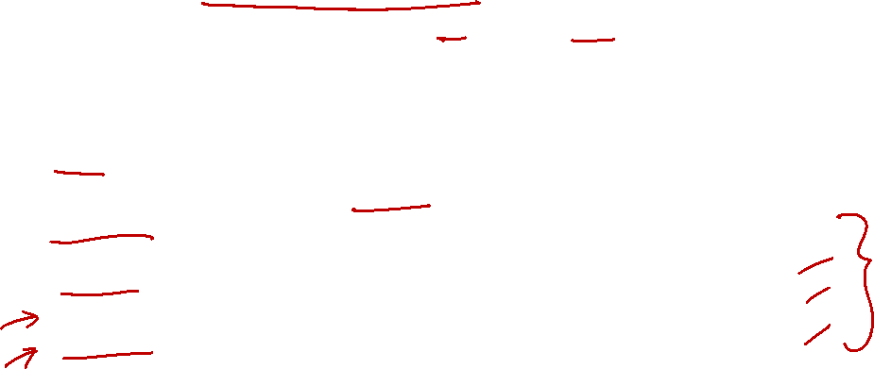
4. General Purpose Registers (2/2)
There are 32 registers in MIPS assembly language:
Can be referred by a number ($0, $1, …, $31) OR
Referred by a name (eg: $a0, $t1)
Name | Register number | Usage
$zero | 0 | Constant value 0
$v0-$v1 | 2-3 | Values for results and expression evaluation
$a0-$a3 | 4-7 | Arguments
$t0-$t7 | 8-15 | Temporaries
$s0-$s7 | 16-23 | Program variables
Name | Register number | Usage
$t8-$t9 | 24-25 | More temporaries
$gp | 28 | Global pointer
$sp | 29 | Stack pointer
$fp | 30 | Frame pointer
$ra | 31 | Return address
$at (register 1) is reserved for the assembler.
$k0-$k1 (registers 26-27) are reserved for the operating system.

Slide 28
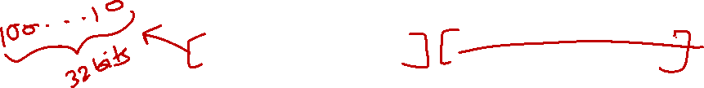
5. MIPS Assembly Language
Each instruction executes a simple command
Usually has a counterpart in high-level programming languages like C/C++, Java etc
Each line of assembly code contains at most 1 instruction
# (hex-sign) is used for comments
Anything from # to end of line is a comment and will be ignored by the assembler
add $t0, $s1, $s2 # $t0 ← $s1 + $s2
sub $s0, $t0, $s3 # $s0 ← $t0 - $s3

Slide 29
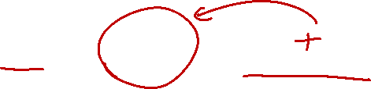
5.1 General Instruction Syntax
add $s0, $s1, $s2
Source 2
Operation (op)
Source 1
Destination
(gets the result)
$s0 = $s1 + $s2
Naturally, most of the MIPS arithmetic/logic operations have three operands: 2 sources and 1 destination

Slide 30
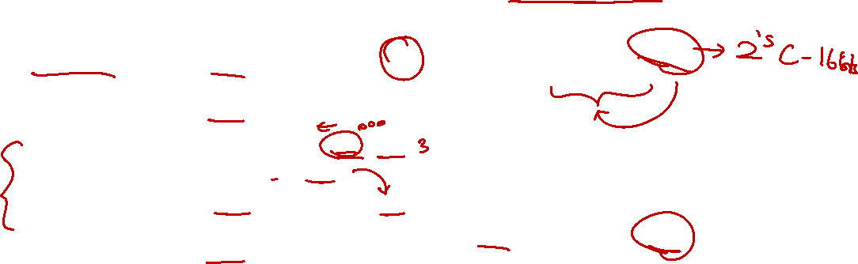
7. MIPS Basic Instructions Checklist
Operation | Opcode in MIPS | Immediate Version (if applicable)
Addition | add $s0, $s1, $s2 | addi $s0, $s1, C16_{2s} C16_{2s} is [-2¹⁵ to 2¹⁵-1]
Subtraction | sub $s0, $s1, $s2
Shift left logical | sll $s0, $s1, C5 C5 is [0 to 2⁵-1]
Shift right logical | srl $s0, $s1, C5
AND bitwise | and $s0, $s1, $s2 | andi $s0, $s1, C16 C16 is a 16-bit pattern
OR bitwise | or $s0, $s1, $s2 | ori $s0, $s1, C16
NOR bitwise | nor $s0, $s1, $s2
XOR bitwise | xor $s0, $s1, $s2 | xori $s0, $s1, C16

Slide 31
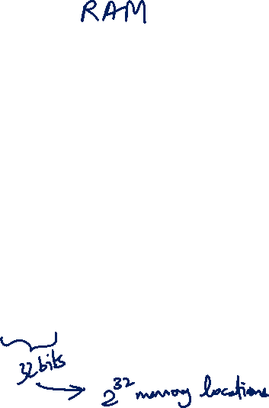
1. Memory Organisation (General)
The main memory can be viewed as a large, single-dimension array of memory locations.
Each location of the memory has an address, which is an index into the array.
Given a k-bit address, the address space is of size 2^{k}.
The memory map on the right contains one byte (8 bits) in every location/address.
This is called byte addressing
Address
Content
0
8 bits
1
8 bits
2
8 bits
3
8 bits
4
8 bits
5
8 bits
6
8 bits
7
8 bits
8
8 bits
9
8 bits
10
8 bits
11
8 bits
:

Slide 32
1.1 Memory: Transfer Unit
Using distinct memory address, we can access:
a single byte (byte addressable) or
a single word (word addressable)
Word is:
Usually 2^{n} bytes
The common unit of transfer between processor and memory
Also commonly coincide with the register size, the integer size and instruction size in most architectures

Slide 33
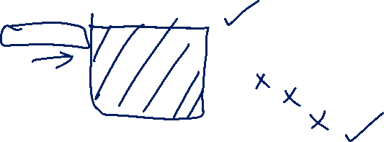
1.2 Memory: Word Alignment
Word alignment:
Words are aligned in memory if they begin at a byte address that is a multiple of the number of bytes in a word.
Example: If a word consists of 4 bytes, then:
Address
Aligned word
0
Byte 0
1
Byte 1
Mis-aligned word
2
Byte 2
3
Byte 3
Question:
How do we quickly check whether a given memory address is word-aligned or not?
4
Byte 4
5
Byte 5
6
Byte 6
7
Byte 7

Slide 34
2. MIPS Memory Instructions
MIPS is a load-store register architecture
32 registers, each 32-bit (4-byte) long
Each word contains 32 bits (4 bytes)
Memory addresses are 32-bit long
NOTE:
Magic number is 32
Name | Examples | Comments
32 registers | $s0-$s7, $t0-$t9, $zero, $a0-$a3, $v0-$v1, $gp, $fp, $sp, $ra, $at | Fast processor storage for data. In MIPS, data must be in registers to perform arithmetic.
2³⁰ memory words | Mem[0], Mem[4], …, Mem[4294967292] | Accessed only by data transfer instructions. MIPS uses byte addresses, so consecutive words differ by 4. Memory holds data structures, such as arrays, and spilled registers, such as those saved on procedure calls.

Slide 35
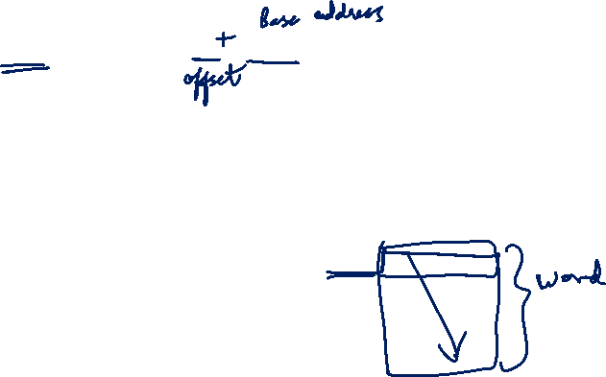
2.1 Memory Instruction: Load Word
Example: lw $t0, 4($s0)
Processor
Memory
………..
$s0
8000
8000
8001
$t0
1
8002
8003
Offset = +4
8004
8005
2
8006
8007
………..
Steps:
Memory Address = $s0 + 4 = 8000 + 4 = 8004
Memory word at Mem[8004] is loaded into $t0

Slide 36

2.2 Memory Instruction: Store Word
Example: sw $t0, 12($s0)
Processor
Memory
………..
$s0
8000
8000
8001
$t0
1
8002
……
………
Offset = +12
8012
8013
2
8014
8015
………..
Steps:
Memory Address = $s0 + 12 = 8000 + 12 = 8012
Content of $t0 is stored into word at Mem[8012]

Slide 37
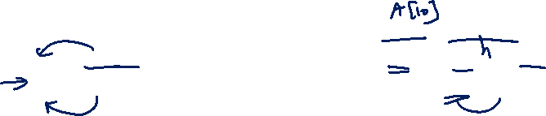
2.3 Load and Store Instructions
Only load and store instructions can access data in memory.
Example: Each array element occupies a word.
Each array element occupies a word (4 bytes).
$s3 contains the base address (address of first element, A[0]) of array A. Variable h is mapped to $s2.
Remember arithmetic operands (for add) are registers, not memory!
C Code | MIPS Code
A[7] = h + A[10];
lw $t0, 40($s3)
add $t0, $s2, $t0
sw $t0, 28($s3)
t0 = A[10];
t0 = h + t0;
A[7] = t0;

Slide 38
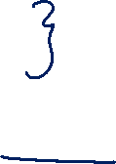
2.4 Memory Instructions: Others (1/2)
Other than load word (lw) and store word (sw), there are other variants, example:
load byte (lb)
store byte (sb)
Similar in format:
lb $t1, 12($s3)
sb $t2, 13($s3)
Similar in working except that one byte, instead of one word, is loaded or stored
Note that the offset no longer needs to be a multiple of 4

Slide 39
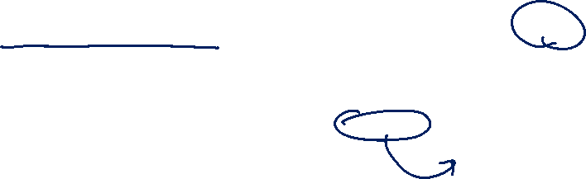
2.4 Memory Instructions: Others (2/2)
MIPS disallows loading/storing unaligned word using lw/sw:
Pseudo-Instructions unaligned load word (ulw) and unaligned store word (usw) are provided for this purpose
Other memory instructions:
lh and sh: load halfword and store halfword
lwl, lwr, swl, swr: load word left / right, store word left / right.
etc…
NOTE:
ulw/usw can be translated to sequence of lb/sb + other operations

Slide 40
5. Array and Loop: Version 1.0
Address of A[] ➔ $t0 Result ➔ $t8 i ➔ $t1 | Comments
addi $t8, $zero, 0 addi $t1, $zero, 0 addi $t2, $zero, 40 loop: bge $t1, $t2, end sll $t3, $t1, 2 add $t4, $t0, $t3 lw $t5, 0($t4) bne $t5, $zero, skip addi $t8, $t8, 1 skip: addi $t1, $t1, 1 j loop end: | # end point # i * 4 # $t4 ⬅ &A[i] # $t5 ⬅ A[i] # result++ # i++

Slide 41
5. Array and Loop: Version 2.0
Address of A[] ➔ $t0 Result ➔ $t8 &A[i] ➔ $t1 | Comments
addi $t8, $zero, 0 addi $t1, $t0, 0 addi $t2, $t0, 160 loop: bge $t1, $t2, end lw $t3, 0($t1) bne $t3, $zero, skip addi $t8, $t8, 1 skip: addi $t1, $t1, 4 j loop end: | # addr of current item # &A[40] # comparing address! # $t3 ⬅ A[i] # result++ # move to next item
NOTE:
Consider the code using pointer arith:
result = 0;
ptr = A;
end = &A[40];
while ( ptr < end ) { if ( *ptr == 0 ) result++; ptr++;
}
The resulting MIPS looks like the code on the left.
Use of “pointers” can produce more efficient code!

Slide 42
2.7 Example: Swapping Elements
C Statement to translate | Variables Mapping
swap( int v[], int k ) { int temp; temp = v[k] v[k] = v[k+1]; v[k+1] = temp; } | k ➔ $5 Base address of v[] ➔ $4 temp ➔ $15
Example: k = 3; to swap v[3] with v[4].
Assume base address of v is 2000.
$5 (k) ← 3
$4 (base addr. of v) ← 2000
swap:
sll $2, $5, 2
add $2, $4, $2
lw $15, 0($2)
lw $16, 4($2)
sw $16, 0($2)
sw $15, 4($2)
$2 ← 12
$2 ← 2012
$15 ← content of mem. addr. 2012 (v[3])
$16 ← content of mem. addr. 2016 (v[4])
content of mem. addr. 2012 (v[3]) ← $16
content of mem. addr. 2016 (v[4]) ← $15

Note: This is simplified and may not be a direct translation of the C code.

Slide 43
quiz solutions

Slide 44
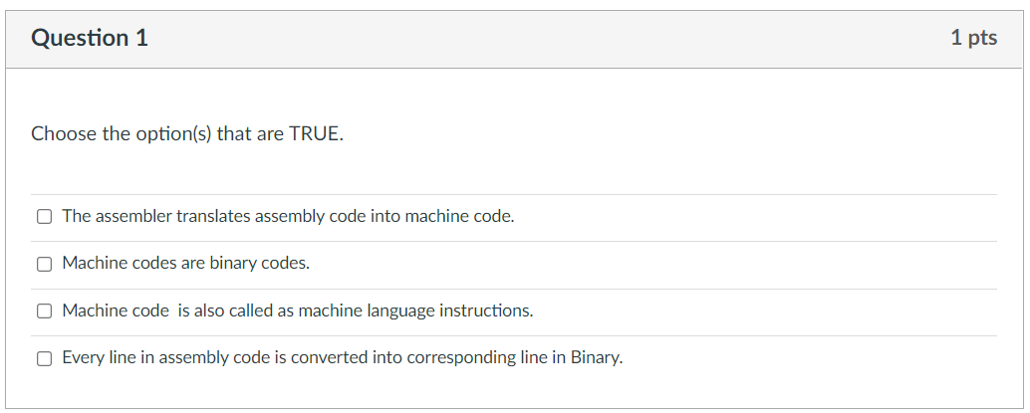
Week-3 MIPS Quiz-1
✓
✓
✓
✓

Slide 45
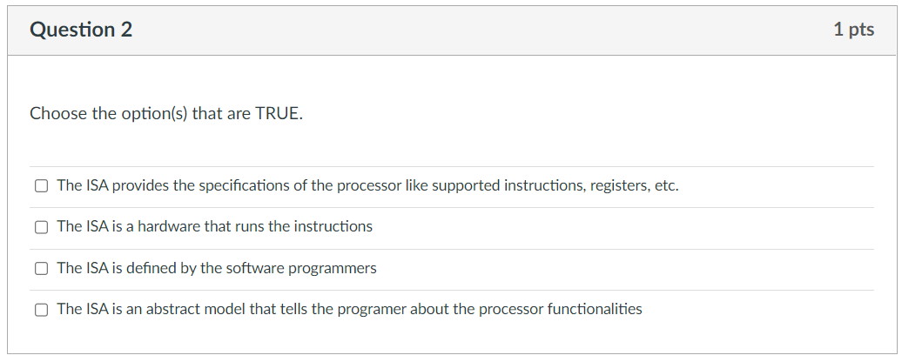
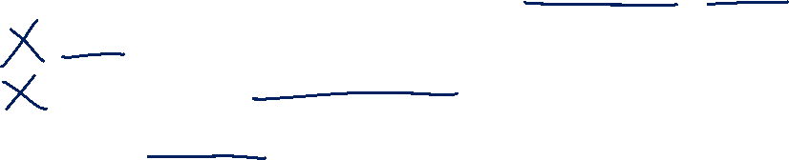
Week-3 MIPS Quiz-1
✓
✓

Slide 46
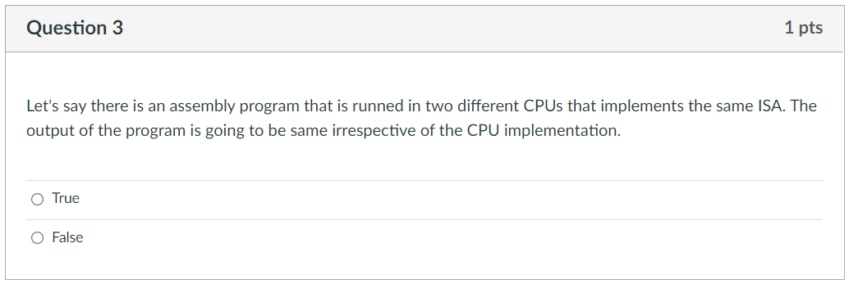
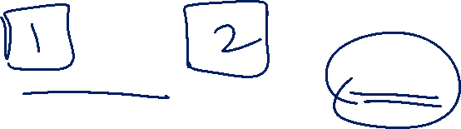
Week-3 MIPS Quiz-1
✓

Slide 47
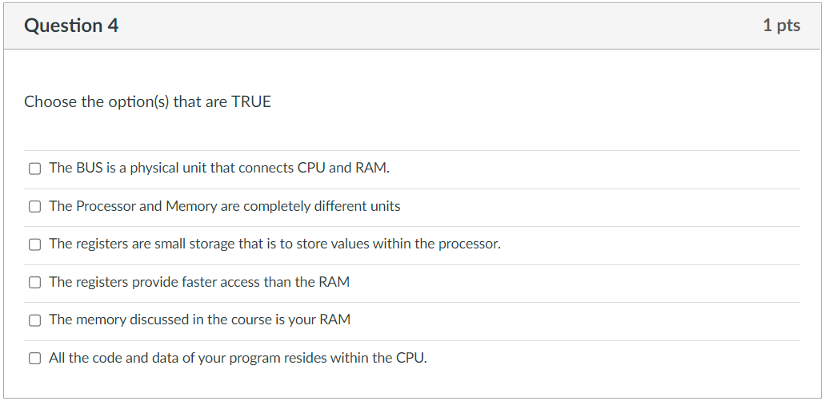

Week-3 MIPS Quiz-1
✓
✓
✓
✓
✓

Slide 48
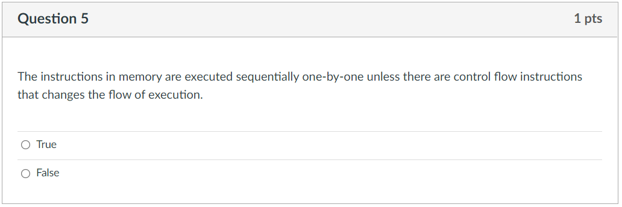
Week-3 MIPS Quiz-1
✓

Slide 49
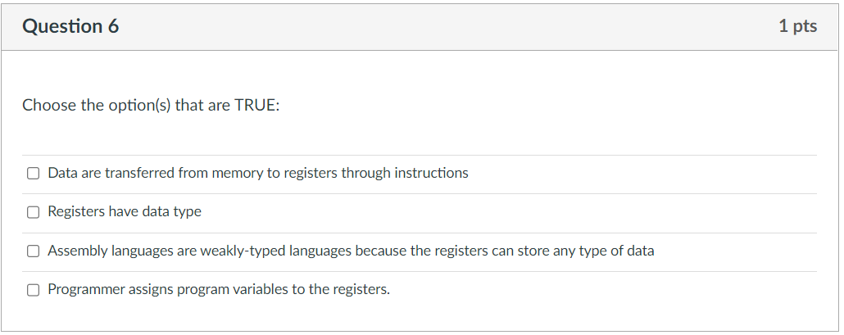
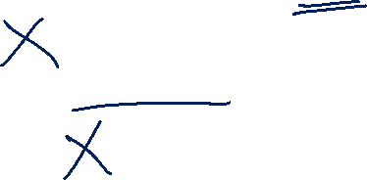
Week-3 MIPS Quiz-1
✓
✓

Slide 50
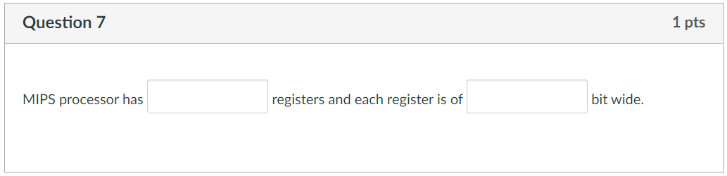
Week-3 MIPS Quiz-1
32
32

Slide 51
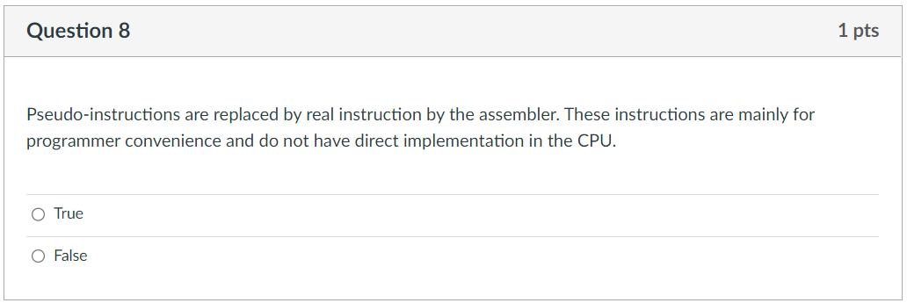

Week-3 MIPS Quiz-1
✓

Slide 52
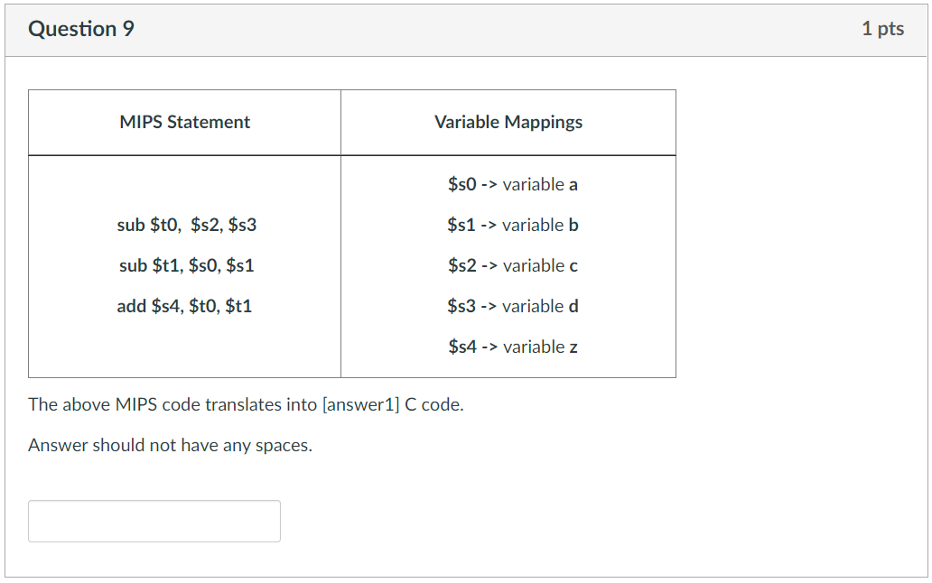
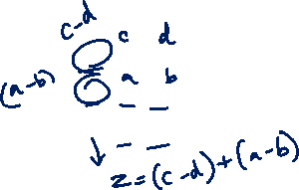
Week-3 MIPS Quiz-1

Slide 53
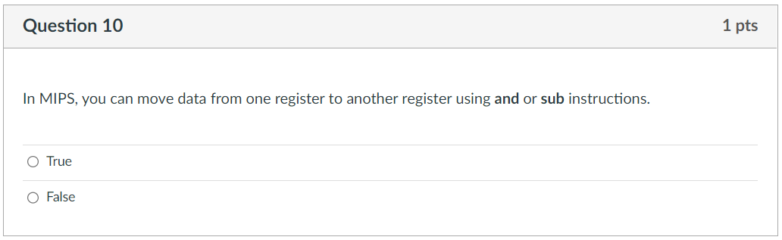
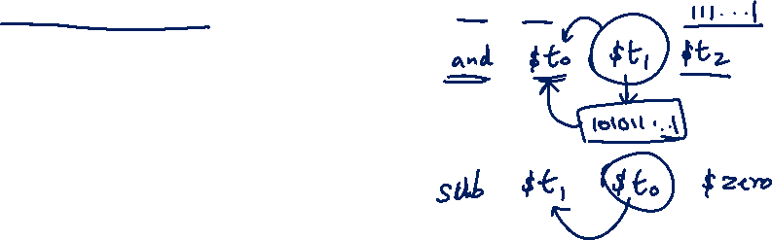
Week-3 MIPS Quiz-1
✓

Slide 54
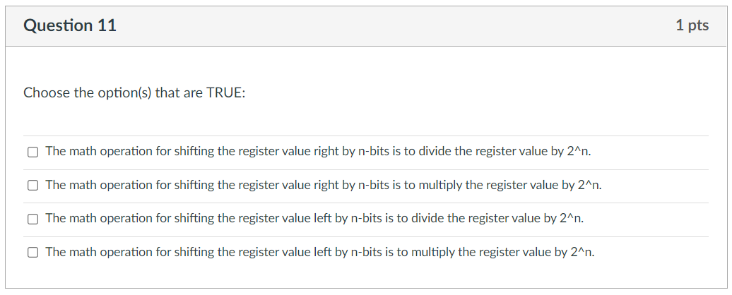
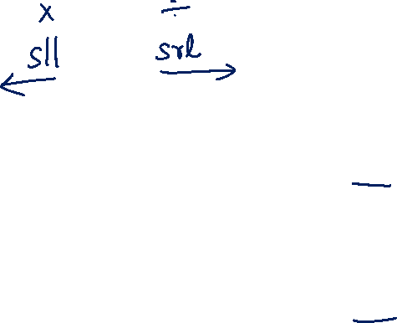
Week-3 MIPS Quiz-1
✓
✓

Slide 55
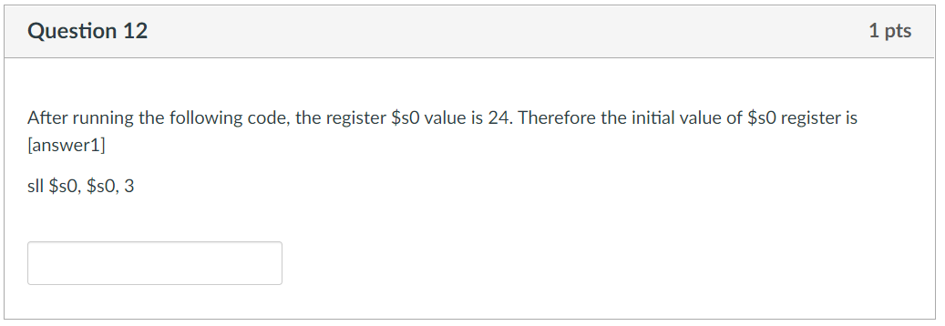
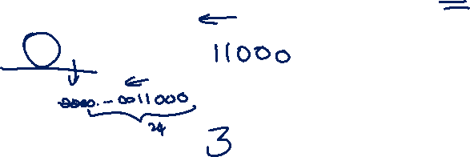
Week-3 MIPS Quiz-1
3

Slide 56
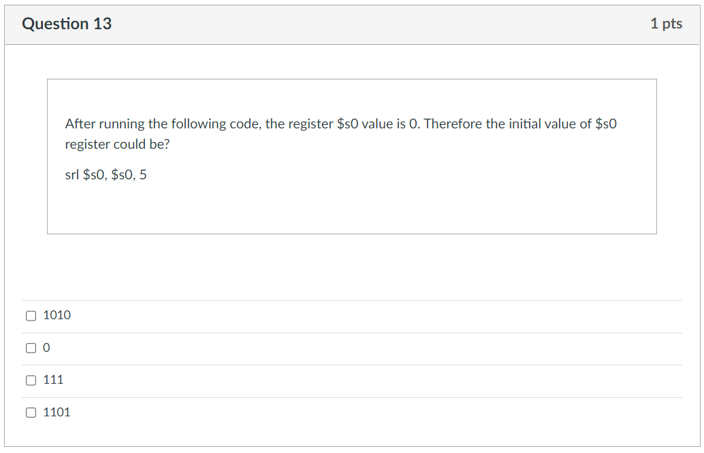
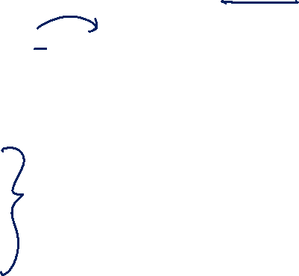
Week-3 MIPS Quiz-1
✓
✓
✓
✓

Slide 57
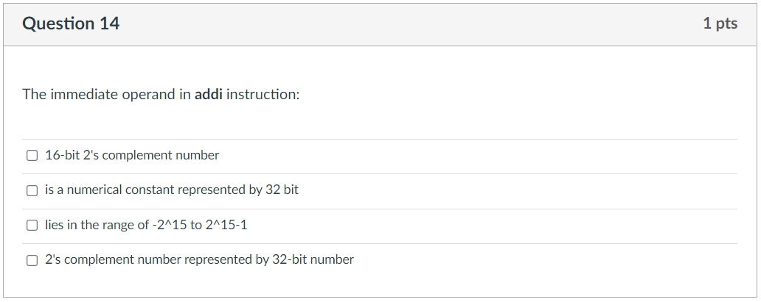

Week-3 MIPS Quiz-1
✓
✓

Slide 58
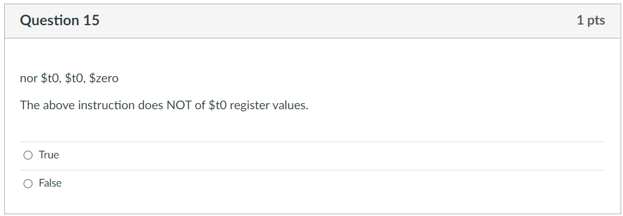
Week-3 MIPS Quiz-1
✓

Slide 59
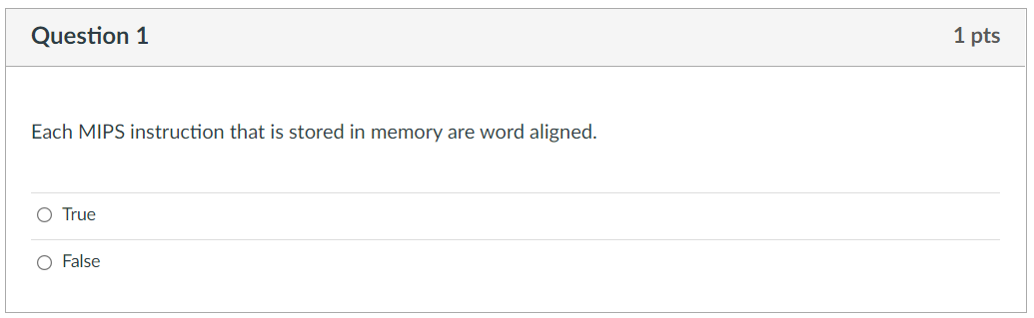
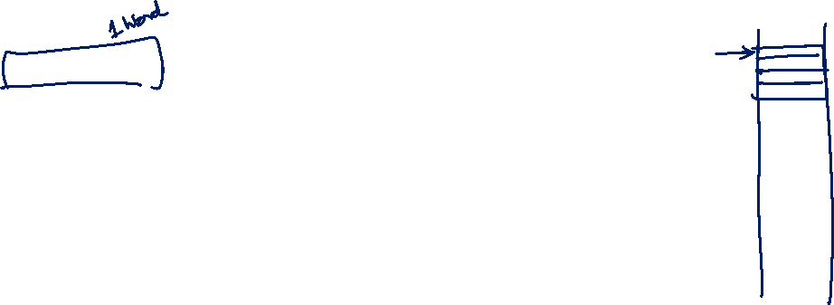
Week-3 MIPS Quiz-2
✓

Slide 60
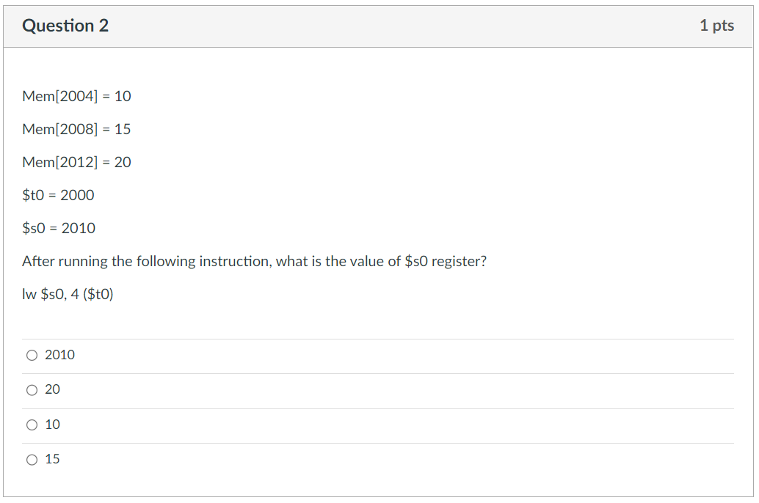
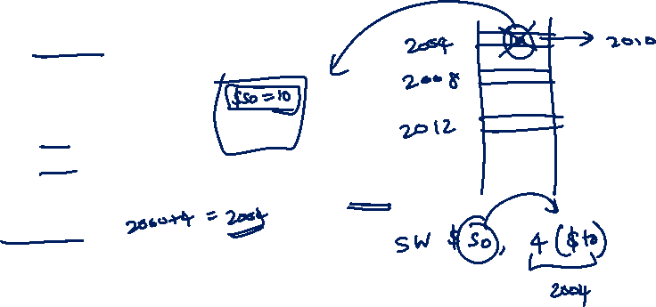
Week-3 MIPS Quiz-2
✓

Slide 61
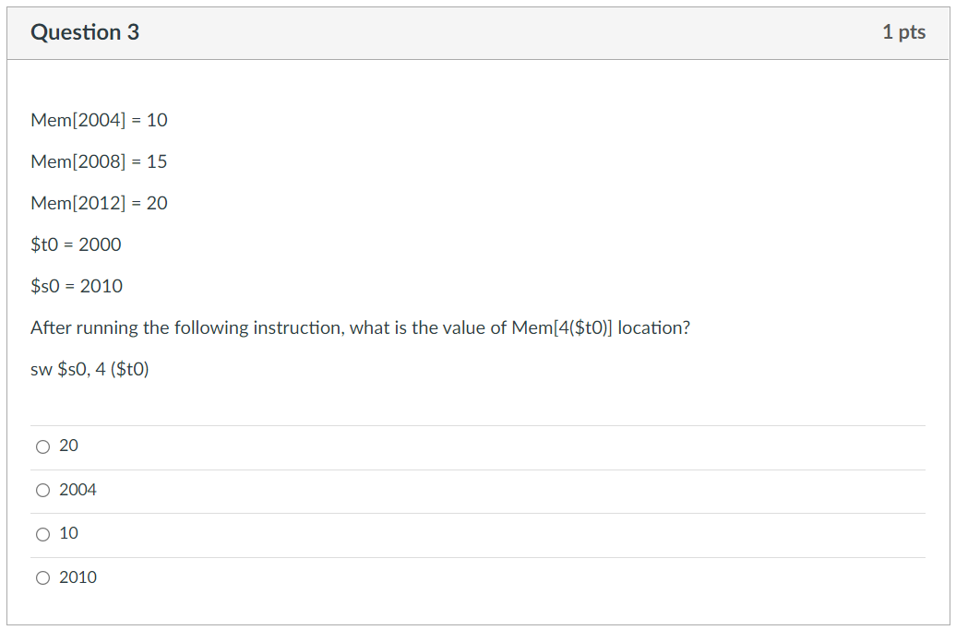
Week-3 MIPS Quiz-2
✓

Slide 62
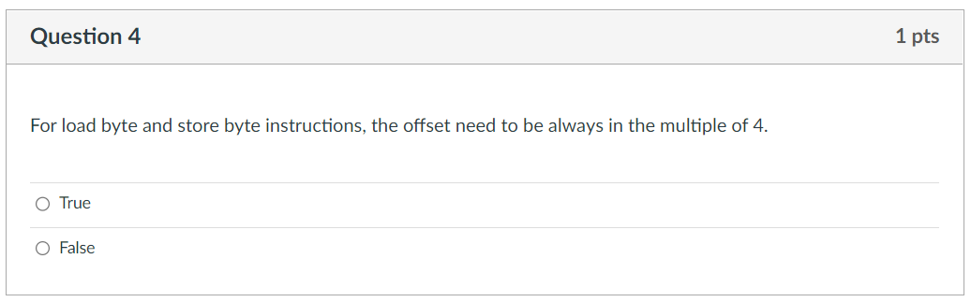
Week-3 MIPS Quiz-2
✓

Slide 63
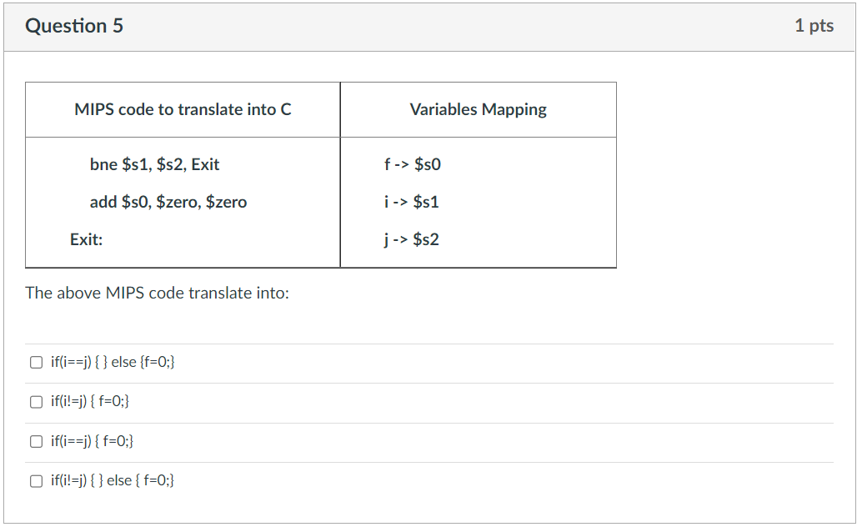

Week-3 MIPS Quiz-2
✓
✓

Slide 64


Week-3 MIPS Quiz-2
✓

Slide 65


Week-3 MIPS Quiz-2
6 * 4 = 24
2 + (4*10) + 1 = 43

Slide 66


Week-3 MIPS Quiz-2
35

Slide 67


Week-3 MIPS Quiz-2
✓

Slide 68

Week-3 MIPS Quiz-2
✓

Slide 69

Mentimeter Quiz

Slide 70

Q1
What is the range of numbers that a MIPS processor can have as an immediate operand, for example in an addi instruction?
A) -256 to 255
B) -2048 to 2047
C) -32768 to 32767
D) 0 to 65535
Notes:
In MIPS, immediate operands for addi instruction is typically 16-bit 2s Complement signed integers (used in instructions like addi, andi, ori, etc.), meaning they range from -32,768 to 32,767.
-2^15 to 2^15-1

Slide 71
Q2
How many words can a MIPS processor with a 32-bit address support?
A) 2³⁰ words
B) 2³² words
C) 2²⁸ words
D) 2³¹ words

Slide 72
Q3
What will be the final value of $t0 after executing the following MIPS code?
addi $t0, $zero, 5
addi $t1, $zero, 3
add $t0, $t0, $t1
sub $t0, $t0, $t1
A) 5 B) 3 C) 8 D) 0

Slide 73

Q4
Assume register $t0 initially contains the decimal value 16. Consider the following MIPS assembly code snippet:
sll $t1, $t0, 2
srl $t2, $t1, 3
After executing this code, what are the decimal values stored in registers $t1 and $t2?
A) $t1 = 18, $t2 = 6
B) $t1 = 64, $t2 = 8
C) $t1 = 4, $t2 = 32
D) $t1 = 64, $t2 = 2

Slide 74

Q5
In MIPS, if the base address of an array (an array of integers) is 0x1000, and each integer is 4 bytes (a word) in size, what would be a valid address for the 3rd element (index 2) of that array?
A) 0x1006
B) 0x1008
C) 0x100A
D) 0x100C

Slide 75

Q6
Assume the following initial state: Register $t0 contains 0x1000, and the memory location 0x1008 holds the decimal value 25. What is the value stored in the register $t1 and memory location 0x1008 respectively after the following MIPS instruction is executed:
lw $t1, 8($t0)
addi $t1, $t1, 1
sw $t1, 8($t0)
A) $t1: 25, Memory at 0x1008: 25
B) $t1: 26, Memory at 0x1008: 26
C) $t1: 25, Memory at 0x1008: 26
D) $t1: 26, Memory at 0x1008: 25

Slide 76
End of File

